Slide 1
Introduction to MS Excel

Slide 2


introduction
It is a spreadsheet program developed by Microsoft.
It runs on Windows, macOS, Android and iOS.
The first version was released in 1985 and has gone through several changes over the years.
However, the main functionality mostly remains the same i.e., organizing data in columns and rows and performing mathematical operations over it.

Slide 3
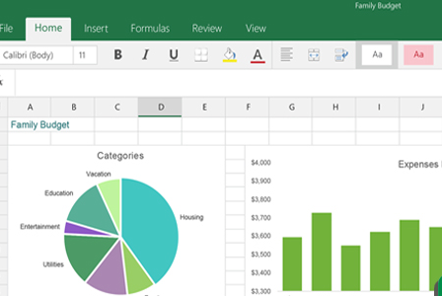






advantages

Slide 4



disadvantages
Limited Data Visualization
Limited Data Capacity:
Excel 2003 and earlier:
Maximum number of rows: 65,536
Maximum number of columns: 256
Excel 2007, 2010, 2013, 2016, and 2019:
Maximum number of rows: 1,048,576
Maximum number of columns: 16,384
Excel for Microsoft 365 (Excel 2019 subscription and beyond):
Maximum number of rows: 1,048,576
Maximum number of columns: 16,384
Limited Automation
Version Compatibility Issues
Manual data Entry Error
Manual data Entry Error

Slide 5





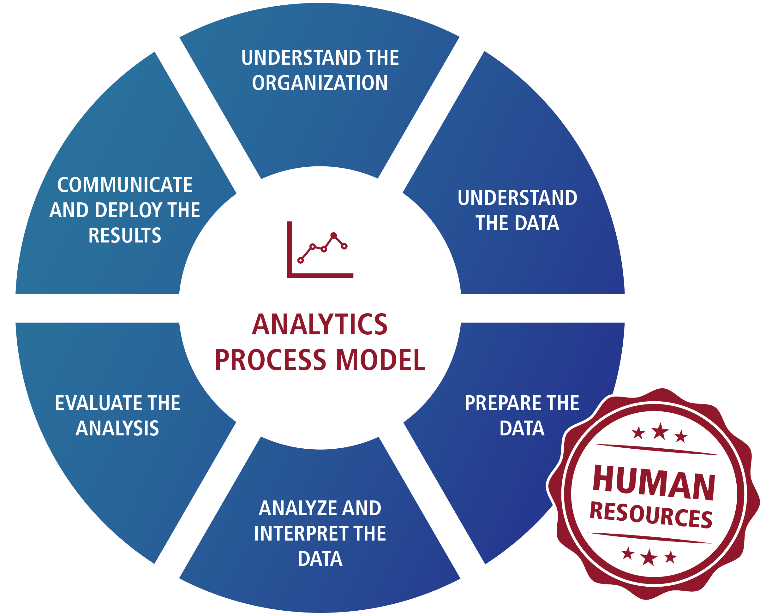


applications

Slide 6
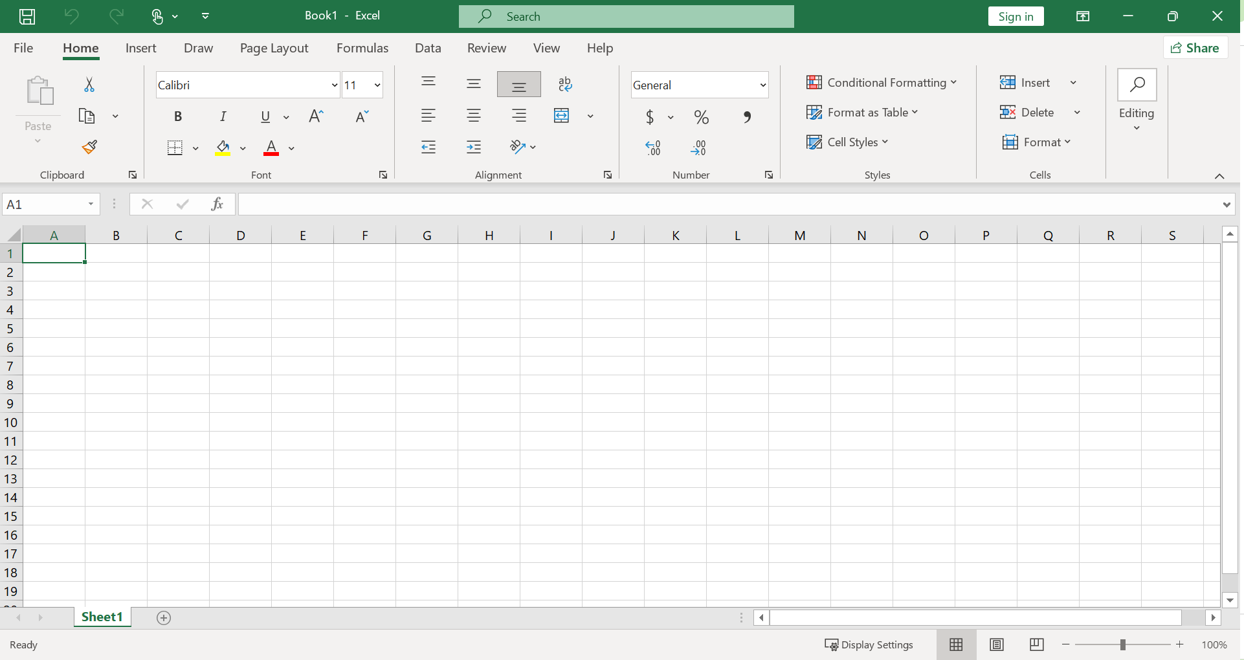
Quick access toolbar
Control Buttons
Title bar
Menu bar
Name box
Formula bar
Tool bar
Spreadsheet area
Dialog box launcher
Scroll bar
Row bar
Column bar
Cell
Mode of excel
Zoom Control
Leaf bar
View Buttons
Status bar

Slide 7


